Slide 1
Interim Demo: Hikari no To
Computer Games Laboratory 2017/2018
Team Pick One:
Muhammad Inshal Uddin
Paul Preißner
Jonas Mayer
Artem Bishev
Technical University of Munich
06.12.2017

Slide 2
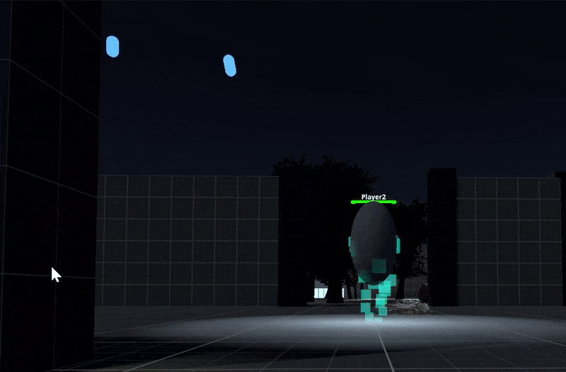
Dungeon Master
Roomscale VR Integration with SteamVR (HTC Vive and Oculus Rift)
Simple Radial Menu for Selection of Abilities and Gestures
Networked Buff and Debuff Ability
Networked Visuals for Crawlers
Next steps:
Rigged Hands
Physics-based Abilities
Design Challenges:
Master Scale?

